Slide 1
Evolution of CMOS device and technology for low power applications
Dr. Sanatan Chattopadhyay
Department of Electronic Science
&
Centre for Research in Nanoscience and Nanotechnology
University of Calcutta

Slide 2
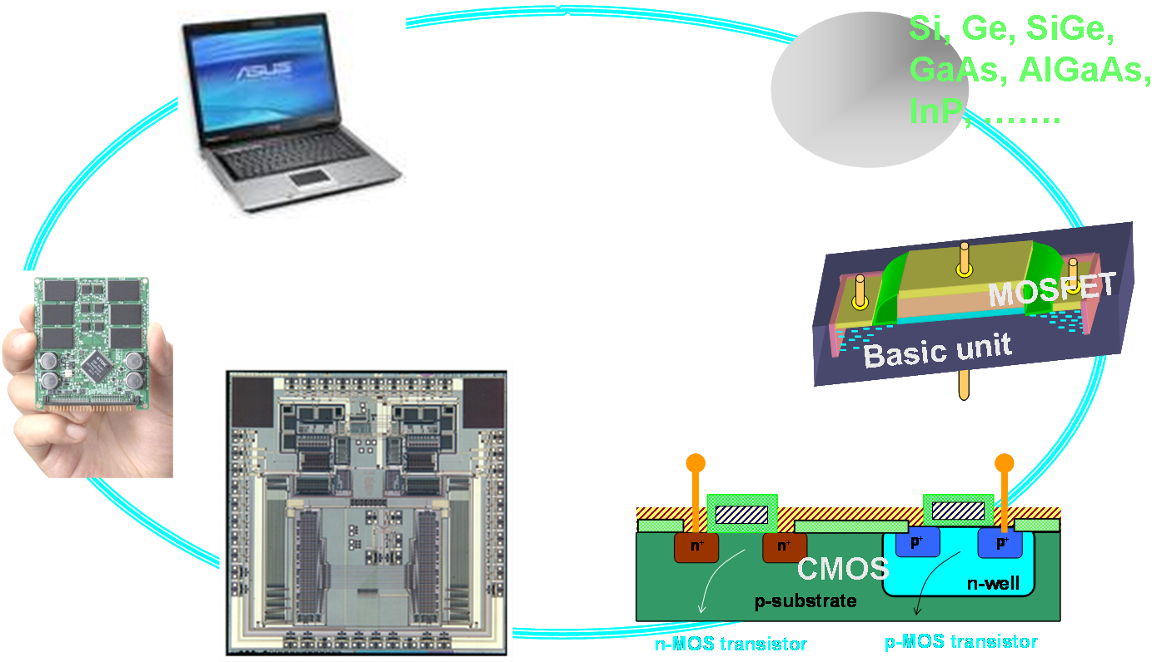
Systems, circuits and devices

Slide 3
Developing an electronic system
Material
Device/Circuit
Circuit/System
Material synthesis
Material processing
Material modeling
Transport study
Computation
Device design
Device modeling
Contacts
Simulation
Devices
Integrated circuits (IC)
Systems
Components
Interconnects

Slide 4
Metal-oxide-semiconductor field effect transistors (MOSFETs)
The workhorse of modern electronic gadgets

Slide 5
Si based CMOS is the key
As a material
Market
Si is abundant in nature
Microelectronic market
High quality native oxide (SiO₂)
80% is dominated by CMOS**
Appropriate mechanical strength
97% is covered by Si
Complementary-Metal-oxide-Semiconductor (CMOS).
P - Metal-Oxide-Semiconductor Field Effect Transistor (p-MOSFET).
N - Metal-Oxide-Semiconductor Field Effect Transistor (n-MOSFET).
CMOS is a combination of an n-MOSFET and p-MOSFET.

Slide 6
MOSFET
MOS
Vertical Electric Field
Gate
FET
Oxide
Source
- - - - - - - - - - -
Drain
Lateral Electric Field
P-Substrate
Channel
Back contact
Two orthogonal electric fields work together to initiate the operation of a MOSFET. Vertical field applied from the gate creates a channel for the carriers and lateral electric field drags the carriers from source to the drain, leading to generate a current along the channel.

Slide 7
MOSFET schematics
Symbol
n-MOS
p-MOS
Symbol:
N⁺⁺
N⁺⁺
n-MOS
p-MOS
P-Sub

Slide 8
MOSFET schematics
V_{gs}
3 or 4-terminal devices:
Gate (G), Source (S) and Drain (D).
Import regions: channel, junctions, gate insulator.
Device parameters: Gate length (L), device width (W), oxide thickness, channel doping.
Schematic:
V_{DS}
G
D
S
Poly-Si gate
Silicide
SiO₂
channel
Junctions
Si-substrate
N__{S/D}
On application of voltages at the gate (V_{G}), and S/D regions (V_{DS}), current flows through the channel (from S to D).
N__{sub}
N__{channel}

Slide 9
Basic processing modules
Oxidation
Implantation
Cleaning, Etching & Lithography
Diffusion
Activation
Annealing
Deposition
Silicidation
Metallization

Slide 10
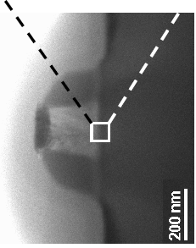
Typical MOSFET process flow
Main features:
Gate oxidation: ~ 800 C;
Dopant activation: 1000 C;
Side nitride spacer wall:
Anisotropic dry etching;
Silicide module: 800 C.
Thermal gate oxidation
Poly-Si deposition and gate definition
LDD implant and activation
Si₃Ni₄ deposition & RIE
HDD implant and activation
Ti deposition and SALICIDATION
Back end process & contact creation

Slide 11
Junction depth (X_{j}) and doping profile
poly-Si
Doping concentration (cm⁻³)
n+
n+
n⁺
X_{j}
n=10²⁰ (cm⁻³)
p=10¹⁶ (cm⁻³)
Depth (nm)
Junction depth: X_{j}
Process parameters:
Implantation
Implantation dose
Implantation energy
Implantation profile
At the depth of X_{j}, the n-type (S/D) and p-type (substrate) doping concentrations will be same.
Low implant energy reduces junction depth, high energy increases it.

Slide 12
Dimension: L_{g}, T_{ox} and W
poly-Si
Oxide thickness: T_{OX}
n+
n+
Channel width: W
Channel length: L
Process parameters:
Process parameters:
Lithography
Wavelength used
Different techniques
Exposure time
Lateral diffusion of dopants
Physical and electrical length
Oxidation time
Oxidation temperature
Oxidation environment
Oxidation techniques
Oxidation kinetics

Slide 13
Physics of the metal-oxide-semiconductor (MOS) systems

Slide 14
Band diagram of MOS system
x
Band bends on application of a gate voltage, leading to redistribution of carrier underneath the oxide layer.
Either the majority carrier or minority carriers will be attracted, depending upon the polarity of the applied voltage and substrate doping nature.
The measurement parameter is the surface potential (Ψ_{s}).
Surface potential is positive when band bend downward and it is negative when it bend upward.
M
O
S
Potential
Energy
..
………
x_{n}
x₁
x₃
Ψ_{s}

Slide 15
3-D band alignment in a MOSEFT
Source
Gate
Potential
Ψ_{s}
Energy
..
………
x_{n}
x₁
x₃
Final surface potential is controlled by the simultaneous action of both the gate-to-channel and source-to-drain voltages.
Ψ_{s}

Slide 16
3-D band alignment in a MOSEFT
Source
Drain
Substrate
Ψ_{B}
Gate
Ψ_{S}
Ψ_{S} ≥Ψ_{B}
Ψ_{B}
Inversion layer
Depletion layer
Bulk region

Slide 17
3-D band alignment in a MOSEFT
Inversion layer is tapered @ drain end. E_{Fn} crosses down to E_{i} near the drain.
V_{d} = 0
E_{i}
Vg > V_{th}
E_{Fp}
E_{i}
E_{Fn}
S
V_{s} = 0
E_{i}
3D
V_{d} > 0
D
E_{i}
V_{s} = 0
Energy band configuration at Vg > V_{th} and V_{d} > 0.
Inversion
Depletion

Slide 18
MOSFET: transport modeling
Charge sheet model:
- channel is very thin, no voltage drops across it.
- vertical electric field is very high compared to lateral electric field.
- total charge at the metal side = to the net charge in the semiconductor side.
Net charge:
S
Current-voltage characteristic:
D

Slide 19
Electrical characteristics
I_{D}
V_{D}
Log (I_{D})
V_{D}
0
0.5 V_{G}
V_{G}
0
0.5 V_{G}
V_{G}
Transfer characteristics
I_{D}
Linear region
Linear region:
V_{g4}
V_{g3}
V_{g2}
Saturation region:
V_{g1}
0
0.5 V_{DD}
V_{D}
Output characteristics

Slide 20
Characteristic parameters
Threshold voltage: V_{th}
Off-state leakage current: I_{off}
On-state current: I_{on}
On-state/off-state current: I_{on}/I_{off}
Trans-conductance: g_{m}
Channel conductance: g_{d}
Sub-threshold slope: S
Drain voltage: V_{dd}
Channel mobility: µ
S/D resistance: R_{s} and R_{d}
DIBL

